Slide 1
EDGE AND FOG COMPUTING
Chapter 1:Introduction to Edge Computing and IoT
Understanding Edge Computing: Evolution, Use cases, advantages, disadvantages,
Overview of edge computing and its significance in IoT
Challenges and opportunities in edge computing.
Self-Learning Topics: Edge devices and their capabilities

Slide 2
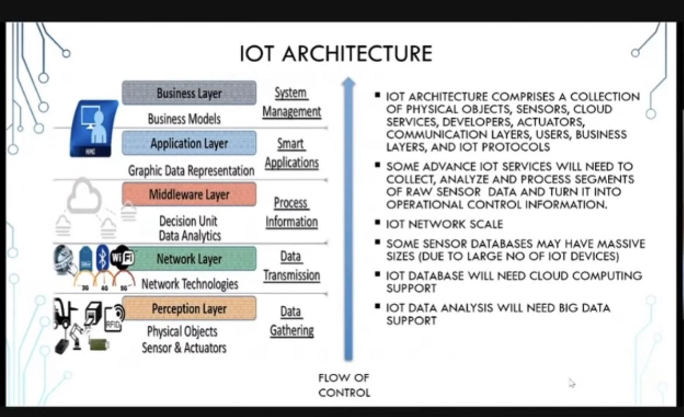
Introduction Of IoT
Internet of Things

Slide 3
Storage and Bandwidth
As we were struggling with large servers and low storage limits, we decided that it was best to forward all this data to large data centres and call their cluster the cloud. It meant more storage, but also resulted into dependency on the internet to access our data.
Then, we made connected devices, also known as Internet of Things (IoTs) that are connected to the cloud and constantly pull and push data into it. It allowed us to store large amounts of data and retrieve it efficiently. But there was one major issue – bandwidth.
With a shortage of bandwidth, we could either increase the number of servers, which would be expensive or send only the most important data to the cloud in order to save bandwidth. Edge and fog computing help us achieve exactly that

Slide 4
Cloud Computing
The primary advantage of cloud-based systems is they allow data to be collected from multiple sites and devices, which is accessible anywhere in the world.
Fog and edge computing are both extensions of cloud networks, which are a collection of servers comprising a distributed network.

Slide 5
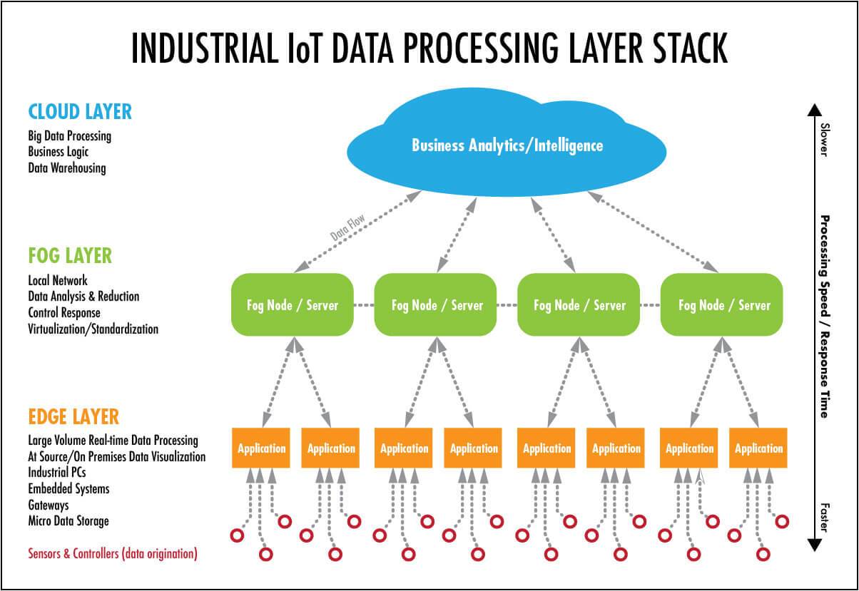

Slide 6
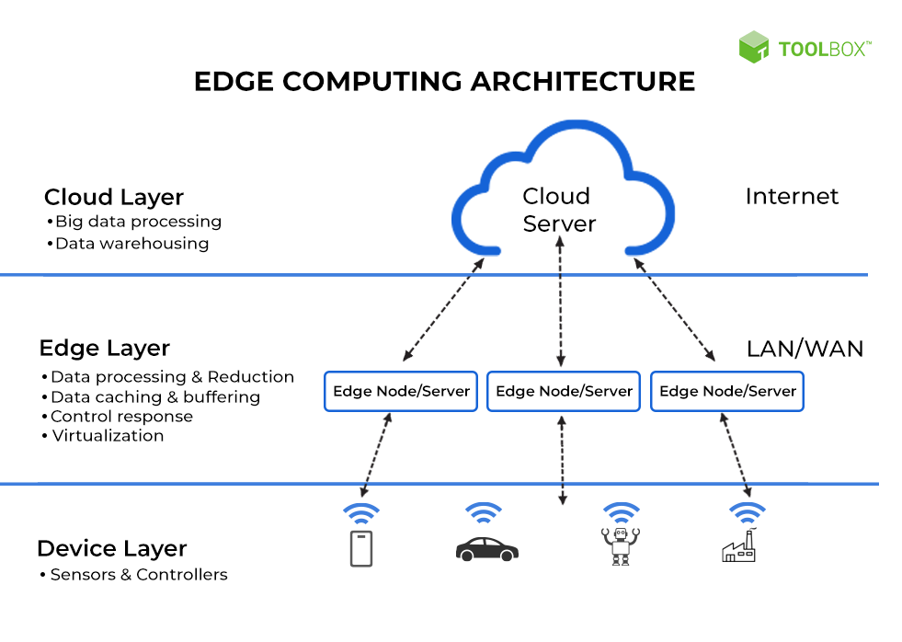

Slide 7
Why edge computing?
There are many drivers for edge computing, other than sheer data-related and IoT-related ones. Moreover, most of the so-called next-generation applications that will really need extremely low latency and extremely high availability are not here yet. And it’s not certain if they will be here anytime soon, even if 5G is what many of them are waiting for. There simply isn’t any guarantee that things like autonomous vehicles or virtual and augmented reality at scale will indeed become a reality soon. In fact, even if 5G is really here there’s totally no guarantee that true self-driving cars will ever be a reality except in specific areas; there is far more to it than meets the eye. VR and AR might find their play here and there but in industrial applications slower than many like to believe as becomes clear in the part on edge computing and Industry 4.0.

Slide 8
Edge computing
Edge computing for the IoT allows processing to be performed locally at multiple decision points for the purpose of reducing network traffic.
The increased distribution of data processing and storage made possible by these systems reduces network traffic, thus improving operational efficiency.
The cloud also performs high-order computations such as predictive analysis and business control, which involves the processing of large amounts of data from multiple sources.
These computations are then passed back down the computation stack so that it can be used by human operators and to facilitate machine-to-machine (M2M) communications and machine learning.

Slide 9
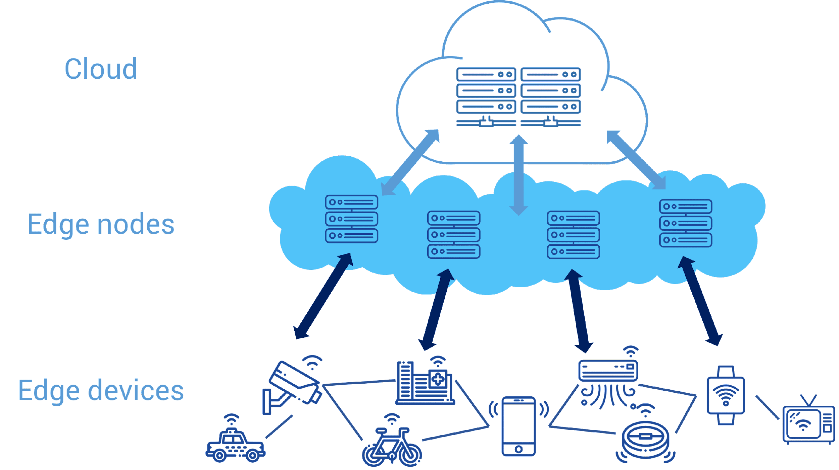
Edge computing is part of a distributed computing topology where information processing is located close to the edge, where things and people produce or consume that information.
https://www.youtube.com/watch?v=RjMS15V_7nQ

Slide 10
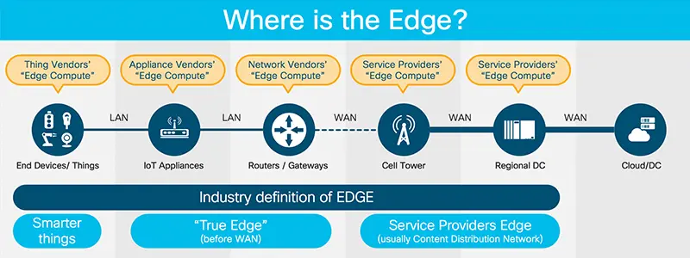
The edge, endpoints and the core – cloud
core (so, cloud, with colocation, hyper scale data centers, enterprise operational data centers and all forms of cloud computing),
edge, being the enterprise-hardened servers and appliances that are not in core datacenters and
endpoints which include the devices on the edge of the network such as sensors and wearables.

Slide 11
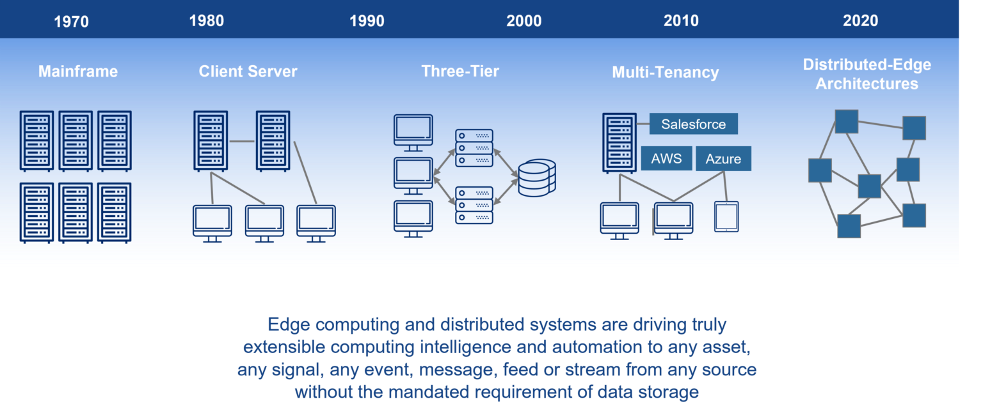
Evalution of EDGE COMPUTING

Slide 12
Use Case : With fast-food chains we have one of many examples in retail and customer-facing, distributed, enterprise initiatives. As you know, many companies have started automating and digitalizing processes, including these customer-facing ones, thereby relying more on digital applications that become more mission-critical. However, in decentralized scenarios where the optimization of customer experience and cost savings, for instance, led to innovation, other issues arise, and the limits of cloud became visible. And here edge computing is positioned as the answer.
The example of the fast-food chain. Not that long ago, ordering something in a fast-food restaurant was a matter of standing in a queue until it was your time and checking you effectively received what you ordered. Today, you have kiosks close to everywhere. Less staff needed, an increased chance that you get what you ordered and so forth. For fast-food chains, this, however, means that these kiosks and the systems behind them have become more mission-critical. Vendors are positioning commercial edge computing solutions here, with, among others, so-called micro data centers and a potential centralized, cloud-based management service.
Self-Driving Vehicles
Fleet Management
Traffic Management
Power Management With Smart Grids & Smart Meters
Safety Monitoring In Remote Oil And Gas Rigs
Smart Video Orchestration
Mobile App Data Management
Stock Market Trading
Gaming

Slide 13
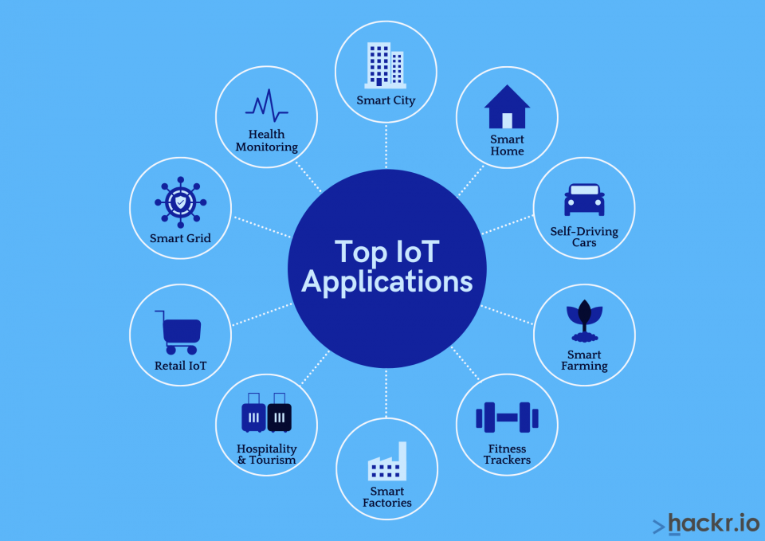

Slide 14
Edge computing and IoT
Instead of completely depending on a cluster of clouds for computing and data storage, edge computing is able to provide intelligent services by leveraging local computing and local edge devices like routers, PCs, and smartphones. The biggest advantage of this all is shorter response time as the data is processed locally.
While many might refer to edge computing as the work that happens at the very edge of the network where the cloud is connected to the physical world via an IoT device, it is much more than just data processing and computation.
By using the processing power of IoT devices, edge computing applications are able to pre-process, filter, score, and aggregate IoT data. It also uses the flexibility of the cloud services to run complicated analysis on that data.

Slide 15
The Internet of Things (IoT) is made up of smart devices connected to a network—sending and receiving large amounts of data to and from other devices—which produces a large amount of data to be processed and analyzed.
Edge computing, a strategy for computing on location where data is collected or used, allows IoT data to be gathered and processed at the edge, rather than sending the data back to a datacenter or cloud.

Slide 16
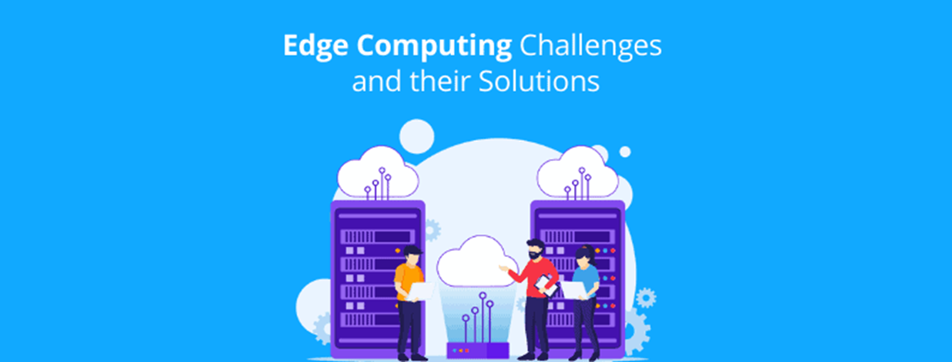
The advancement of the Internet of Things (IoT) and Cloud Computing have pushed the horizon for a new paradigm in computer science that calls for processing the data at edge networks – i.e., edge computing. Edge Computing essentially takes memory and computing out of traditional data centers to bring them as close as possible to the location where they are needed, like mobile phone devices, tablets, wireless earphones, etc.
This technology has the potential to provide a reasonable computation platform when compared to the cloud, thus enhancing battery life, data safety, and privacy. However, integrating edge computing into other sectors is not void of challenges.
There are still a few major challenges that need to be overcome to make edge computing efficient, stable, and user-friendly.

Slide 17

Challenge: Network Bandwidth
In traditional networks, enterprises would allocate higher bandwidth at central data centers and lower bandwidth to the endpoints. Whereas, in an edge computing server, more bandwidth is required across all individual ends of the server. This creates a need for more bandwidth when compared to the traditional networks.
Solution: As per the current scenario, the Edge Computing server needs to allocate higher bandwidth to data centers as well as endpoints therefore, the edge server requires comparatively more bandwidth than the traditional network which, in turn, leads to excessive consumption of data.
This patent provides a unique Control Delivery Network (CDN) in which each edge server is marked with a fixed threshold value of bandwidth consumption. If due to any terminal request, the current load exceeds the preset threshold, the target content extraction request is transferred to the other edge server having a higher threshold value.

Slide 18
Challenge: Distributed Computing
In most of the servers, the set of modules are placed far apart from each other in a distributive manner. Whereas, edge computing tends to bring all the systems closer to the computational areas. This creates a conflict as the business server needs to consider the edge server as an additional aspect during computation.
Due to the limited processing capacity, a large number of distributed edge nodes cannot provide all services completely and independently and need to cooperate with other edges or cloud data centers through an optical transport network which itself needs to provide a large number of routes to fulfill the requirements of distributed edge node in areas like autonomous cars and blockchain.
This invention suggests to breaks down the entire edge server into multiple routes with route arranging devices located at the edge center. On receiving a connection request, the appropriate route is searched (by matching source and destination node requirements) and if not found, a new route is formed as per the service and bandwidth requirements.
Challenge: Latency
Latency is essentially the delay caused by data transmission. In an edge server, if the computation is taking place closer to data or if the compute is only happening at the center, latency can be reduced. But usually, due to distributive computing and both-ways computation, latency issues occur.
Solution
This invention suggests that by analyzing network architecture comprising of an edge data center and edge nodes, programmatically expected latency associated with both node and core can be determined. After this, the difference between the latency of both can be devised out on basis of which, the edge transfer process can be optimized.

Slide 19
Challenge: Security and Encryption
Each device in an edge server represents another potentially vulnerable endpoint, and the internet of things (IoT) is notorious for its lack of robust security. Also, smaller data centers like embedded devices are not designed in accordance with security measures and aren’t updated as often as they should be.
Solution
Due to the high amount of data exchange between the data center and the edge, edge computing poses high technical and physical security issues. Also, in the case of the embedded or micro-embedded devices as a part of an edge server, security mechanisms need to be scaled and decentralized. Also, it requires more hardware.
The invention relates to a blockchain-based edge computing security encryption method in which, the autonomous car receives a traffic data request from the edge module. The car (edge data center), authenticates the request using a multi-level verification system based on encryption and blockchain and accordingly generates action in the steering edge node.

Slide 20
Challenge: Operational Constraints
Due to multiple edge receivers placed at certain distances from the data center, troubleshoot and repair of any issue that occurred in the framework needs a lot of logistic as well as manual input hence increasing the cost of maintenance.
Solution
This invention suggests methods to design a tool comprising of multiple chipsets which are situated at multiple edges in the entire server. These chipsets identify the software and hardware resources needed to troubleshoot certain issues in order to reduce the human effort every time if a node underperforms or goes down.
Challenge: Data Accumulation
Collecting huge chunks of data at either the edge server data center or the edge node poses many security and accessibility issues. Also, the transfer of bigger quantities of data needs more innovative techniques which are yet being researched in the market.
Solution
The patent suggests a data retrieval server with an industrial information table for storing edge IDs. These IDs correspond to edge servers operated and managed by a company by associating the edge IDs with an industry ID for identifying industry and an ID of the company/organization belonging to the industry. In this way, a huge amount of data can be divided, stored, and accessed easily in an edge network.

Slide 21
Challenge: Moving System Constraints
Most of the devices applying edge computation such as mobile devices, laptops, in-ear-monitors as well as wireless earphones are a part of a mobile frame or are with a person in most cases. Implementing exchange of data, security, access to cloud/internet and many other features in moving state is a challenge that needs to be overcome.
Solution
The areas like Mobile Edge Computing, when the edge server is moving, and various functionalities of the edge server (especially task migration system) might not function properly. One of China’s elite C9 league institutes Harbin Institute of Technology filed a patent numbered CN111031102A which provides a solution to the challenges caused when the frame is moving.
In this invention, various tasks are allocated separate edge servers so that, at one time from one system, only a single task (Single edge server) is active. This, in turn, reduces exchange between edge data center and node, thus reducing inefficiency caused due to mobility of edge node.

Slide 22
Challenge: Unified Architecture and Release Processes
In order to accommodate distributive computing with feasible bandwidth requirements and achievable logistics, a better architecture is required to exploit edge computing features in a better way.
Solution
Complex, inefficient and unstable architecture if applied by the traditional methods depletes the performance of Edge deployment targets as well as traditional data centers. The invention suggests architecture with separate data collecting layer, a cloud computing processing layer, and an edge computational processing layer. The data collection layers gather plant data whereas the two computing layers form the network for calculating an edge event and providing the preset output. An edge calculation processing layer is connected with industrial SDN (Software-delivery network) through a global decision module.

Slide 23
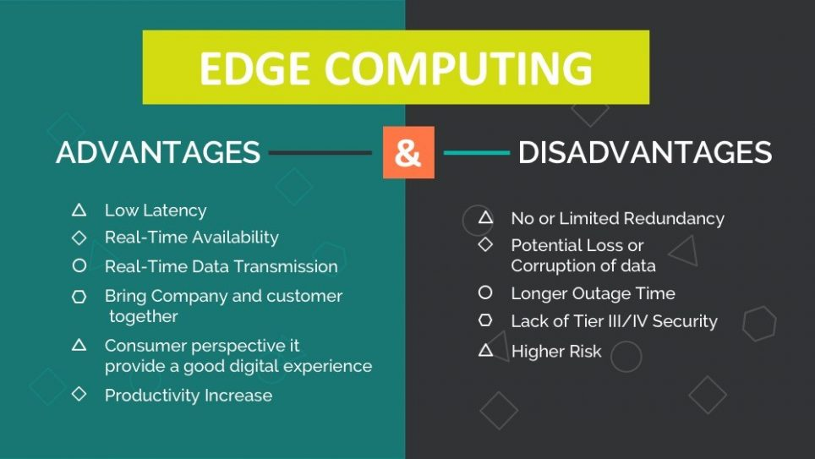

Slide 24
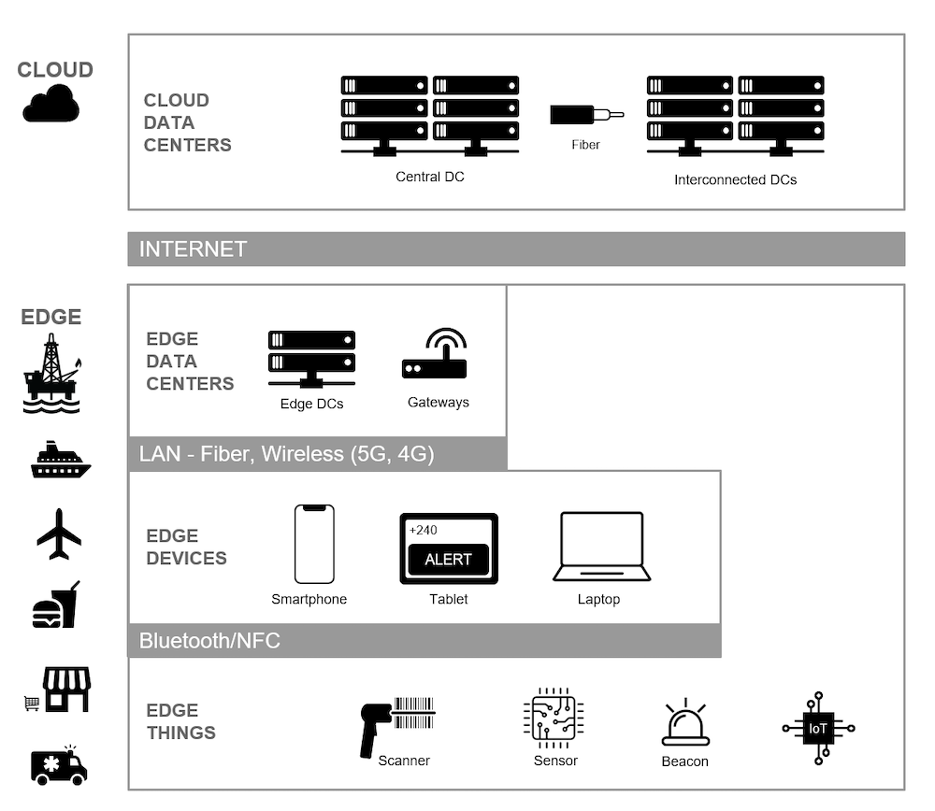
Chapter 2.Edge Computing Infrastructure
Edge computing architectures and components:
Requirements and views for Edge architecture

Slide 25


